Slide 1



Unified DLP Solutions for Email System
TMP-2023-24-082

Slide 2
TEAM MEMBERS
Supervisor: Mr. Amila Senarathne
Co-Supervisor :
STUDENT NAME | STUDENT ID
Keshani SK (Leader) | IT20299002
Fayas ACM | IT20637828
Logu JJ | IT20638818
Ahamed RR | IT20650902
03/11/2023

Slide 3
INTRODUCTION
Enhancing Data Leakage Prevention (DLP) with Key Components.
Proactive Protection against Data Breaches.
Used advanced technologies like Natural Language Processing (NLP) and Machine Learning to accomplish its objectives.
Optimizing User Experience and Response
03/11/2023

Slide 4


RESEARCH PROBLEM
Early Detection of Unauthorized Access
Machine Learning for Data Leakage Classification
Real-Time Phishing Email Detection
Content Analysis for Deeper Insights using NLP
03/11/2023

Slide 5
MAIN OBJECTIVE
To enhance email security and prevent unauthorized access to sensitive email content, safeguarding against data breaches through the implementation of advanced DLP.
03/11/2023

Slide 6




SUB-OBJECTIVE
Abnormal Login Analysis for Email-Based DLP Systems
Detect unusual logins in email systems and respond with alerts or additional security measures.
Classify data leakage level with machine learning
Natural Language Processing for Phishing Email Detection
Classify the severity of data leakage incidents using machine learning to prioritize responses and minimize damage
Identify phishing attempts in emails and take actions to protect against email-based threats
Utilizing NLP Techniques for Content Analysis in Email Systems
Automatically analyze email content using NLP to identify sensitive information, patterns
03/11/2023

Slide 7
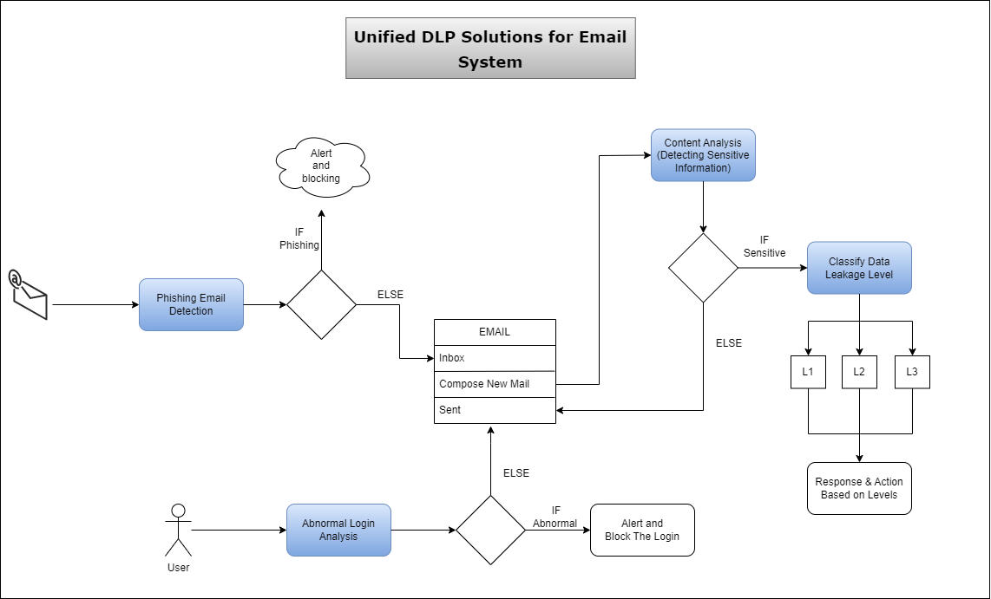
OVERALL SYSTEM DIAGRAM
03/11/2023

Slide 8

ABNORMAL LOGIN ANALYSIS FOR EMAIL-BASED DLP SYSTEMS
LOGU JJ | IT20638818
CYBERSECURITY
IT20638818 | Logu JJ | TMP-2023-24-082
03/11/2023

Slide 9
BACKGROUND
What is the abnormal login?
Why abnormal login Analysis important?
benefic of abnormal login analysis?
IT20638818 | Logu JJ | TMP-2023-24-082
03/11/2023

Slide 10
RESEARCH PROBLEM
How can abnormal login activities be effectively detected and differentiated from legitimate logins?
My proposed solution addresses these challenges by selecting the Random Forest Classifier algorithm to train the model. This analysis detects abnormal logins in real-time for users.
IT20638818 | Logu JJ | TMP-2023-24-082
03/11/2023

Slide 11


OBJECTIVE
Sub-Objectives
User Behavior Profiling:
Geographic Analysis
Sequential Login Analysis:
Improve the overall detection performance for potential security threats and abnormal activities.
Ensuring the accuracy of the prediction
Main Objective
Abnormal Login Analysis in DLP systems is to promptly detect and respond to unusual or unauthorized login attempts.
IT20638818 | Logu JJ | TMP-2023-24-082
03/11/2023

Slide 12
METHODOLOGY
IT20638818 | Logu JJ | TMP-2023-24-082
03/11/2023

Slide 13
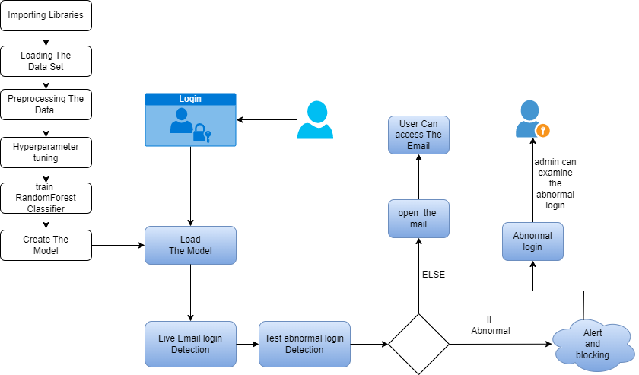
SYSTEM DIAGRAM
IT20638818 | Logu JJ | TMP-2023-24-082
03/11/2023

Slide 14
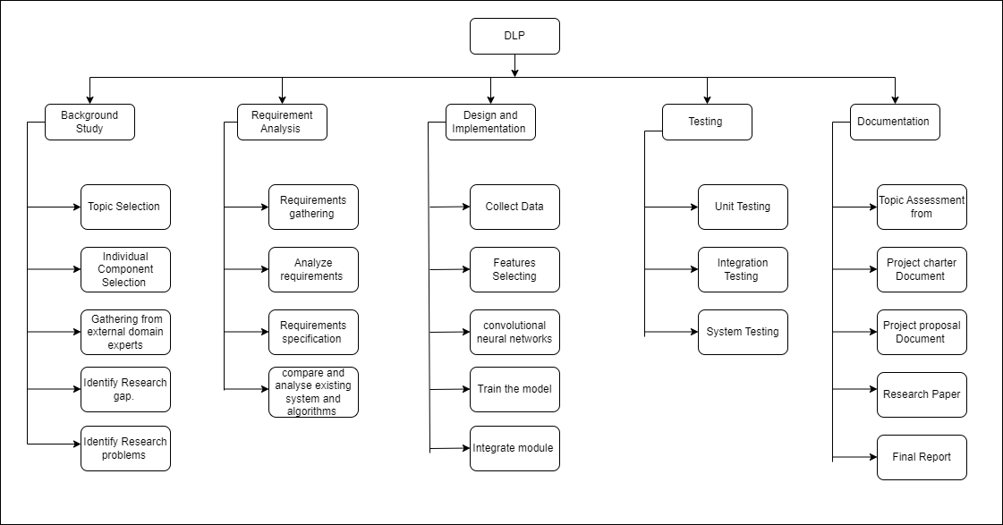
WORK BREAKDOWN STRUCTURE
IT20638818 | Logu JJ | TMP-2023-24-082
03/11/2023

Slide 15
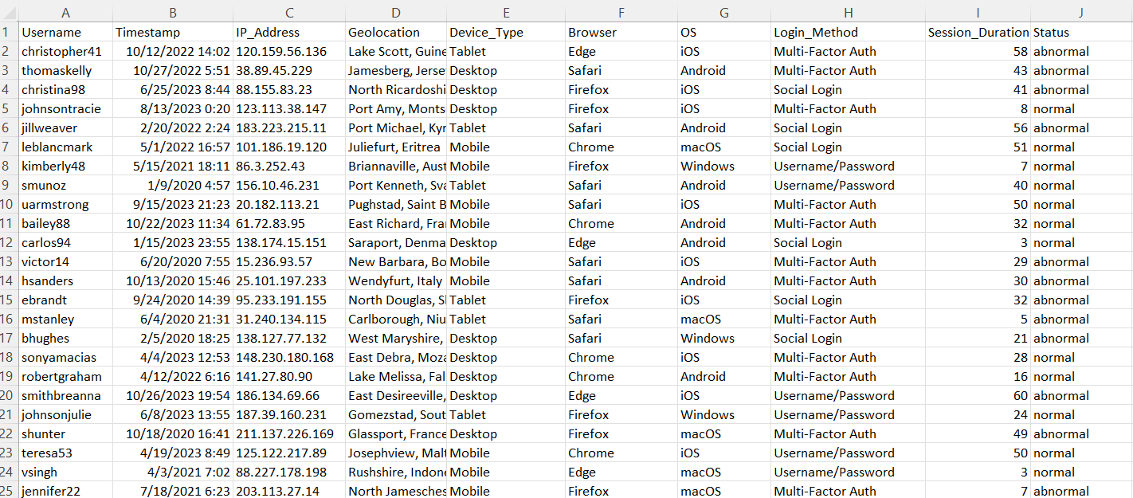
DATASET
IT20638818 | Logu JJ | TMP-2023-24-082
03/11/2023

Slide 16
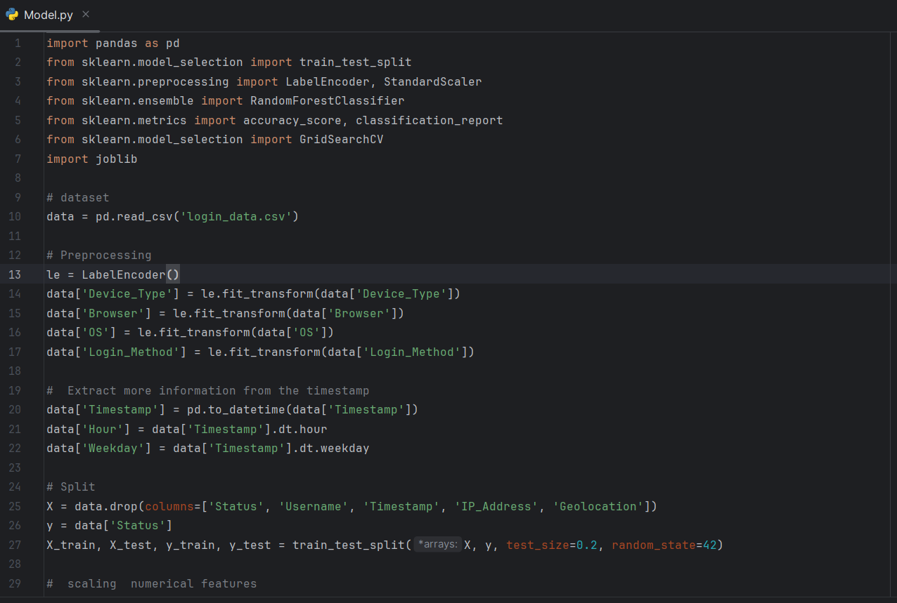
CODE
IT20638818 | Logu JJ | TMP-2023-24-082
03/11/2023

Slide 17
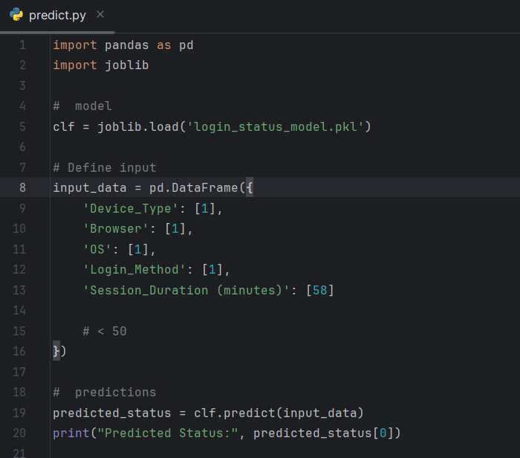
CODE
IT20638818 | Logu JJ | TMP-2023-24-082
03/11/2023

Slide 18
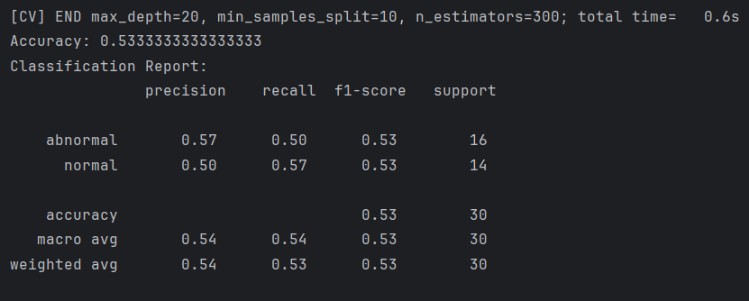
OUTCOME
IT20638818 | Logu JJ | TMP-2023-24-082
03/11/2023

Slide 19
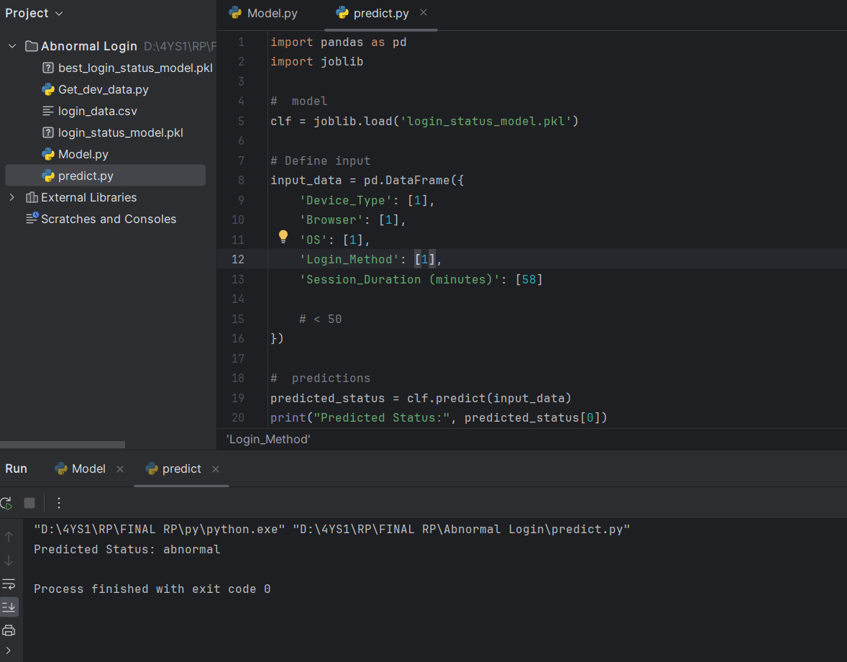
OUTCOME
IT20638818 | Logu JJ | TMP-2023-24-082
03/11/2023

Slide 20
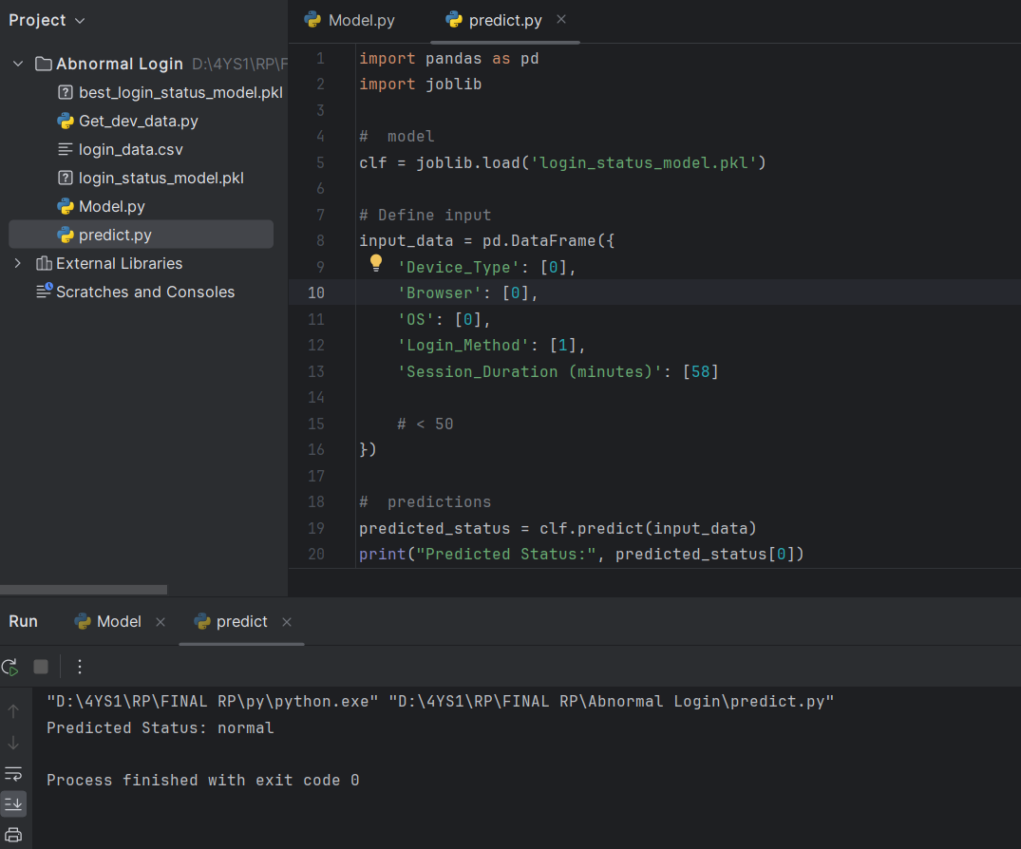
OUTCOME
IT20638818 | Logu JJ | TMP-2023-24-082
03/11/2023

Slide 21
DEMO
IT20638818 | Logu JJ | TMP-2023-24-082
03/11/2023

Slide 22
REFERENCES
(N.d.-a). Researchgate.net. Retrieved November 2, 2023, from https://www.researchgate.net/publication/221359205_Detecting_Abnormal_Changes_in_E-mail_Traffic_Using_Hierarchical_Fuzzy_Systems
S. J. Stolfo, S. Hershkop, H. Chia-Wei, L. Wei-Jen, 0. Nimeskern, and W. Ke, "Behavior-based modeling and its application to email analysis," ACM Transactions on Internet Technology, vol. 6, no. 2, pp. 187-221, 2006.
M. J.-H. Lim, M. Negnevitsky, and J. Hartnett, "A fuzzy approach for detecting anomalous behaviour in e-mail traffic," in 4th Australian Digital Forensics Conference, C. Valli and A. Woodward, Eds. Perth, Western Australia: School of Computer and Information Science, Edith Cowan University, 2006, pp. 36 - 49.
. J. Stolfo, S. Hershkop, K. Wang, 0. Nimeskern, and C. W. Hu, "A behavior-based approach to securing email systems," in Computer Network Security, ser. Lecture Notes in Computer Sci
IT20638818 | Logu JJ | TMP-2023-24-082
03/11/2023

Slide 23

NATURAL LANGUAGE PROCESSING FOR
PHISHING EMAIL DETECTION
AHAMED RR | IT20650902
CYBERSECURITY
IT20650902 | Ahamed RR | TMP-2023-24-082
03/11/2023

Slide 24

BACKGROUND
What is a phishing email?
Phishing is an attempt to steal sensitive information or break into organization's accounts.
Attachments, Malicious links
Why it’s important in DLP?
Protect Sensitive Information, Maintain Compliance, Ensure Business Continuity, and Safeguard their Reputation.
IT20650902 | Ahamed RR | TMP-2023-24-082
03/11/2023
Notes:
Phishing is an attempt to steal sensitive information or break into organization's accounts. Phishing emails can also work by sending the victim an attachment that contains malware. When the victim opens the attachment, the malware is installed on their computer, and it can then steal their sensitive information or take control of their computer.
Why it’s important in DLP: phishing email detection is a critical aspect of DLP because it helps organizations protect sensitive data, maintain compliance, ensure business continuity, and safeguard their reputation. It complements other DLP measures by addressing a common and highly effective attack vector used by cybercriminals to compromise data security.

Slide 25
RESEARCH PROBLEM
Traditional methods like rule-based systems may not be capable of identifying phishing emails accurately.
Challenge of balancing false positives and false negatives when detecting phishing emails.
False Positives - Legitimate email classify as phishing
False Negative - Phishing email classify as legitimate
Solution : To solve these problem our approach is compared to previous work because it focuses on the natural language text contained in the attack, performing semantic analysis of the text to detect malicious intent.
IT20650902 | Ahamed RR | TMP-2023-24-082
03/11/2023
Notes:
Balancing False Positives and False Negatives:
False Positives: These occur when a legitimate email is incorrectly classified as a phishing email. False positives can lead to genuine communications being moved to spam folders, which can inconvenience users and potentially lead to missed opportunities.
False Negatives: These occur when a phishing email is incorrectly classified as a legitimate email. False negatives can lead to security breaches and data loss, as malicious emails go undetected.

Slide 26
OBJECTIVE
Sub-Objectives
Early Detection - To minimize the chances of user interaction with malicious content.
Accurate Detection - Accurate detection of phishing emails while minimizing false positives.
Real-Time Monitoring - Continuously monitor incoming emails in real-time to detect and respond to phishing threats.
Main Objective
To develop an effective machine learning model for classifying emails as phishing or legitimate, with a focus on using NLP techniques.
IT20650902 | Ahamed RR | TMP-2023-24-082
03/11/2023
Notes:
Main Objective: The main objective of Phishing Email Detection in DLP system is to proactively identify and block phishing emails to prevent unauthorized access to sensitive data, reduce the risk of data breaches, and protect the organization's assets and reputation.
Sub-Objectives:
• Early Detection - Identify phishing emails as early as possible in the email delivery process to minimize the chances of user interaction with malicious content.
• Accurate Detection - Develop and implement advanced algorithms and techniques for accurate detection of phishing emails while minimizing false positives.
• Real-Time Monitoring: Continuously monitor incoming emails in real-time to detect and respond to phishing threats promptly.

Slide 27
METHODOLOGY
IT20650902 | Ahamed RR | TMP-2023-24-082
03/11/2023

Slide 28
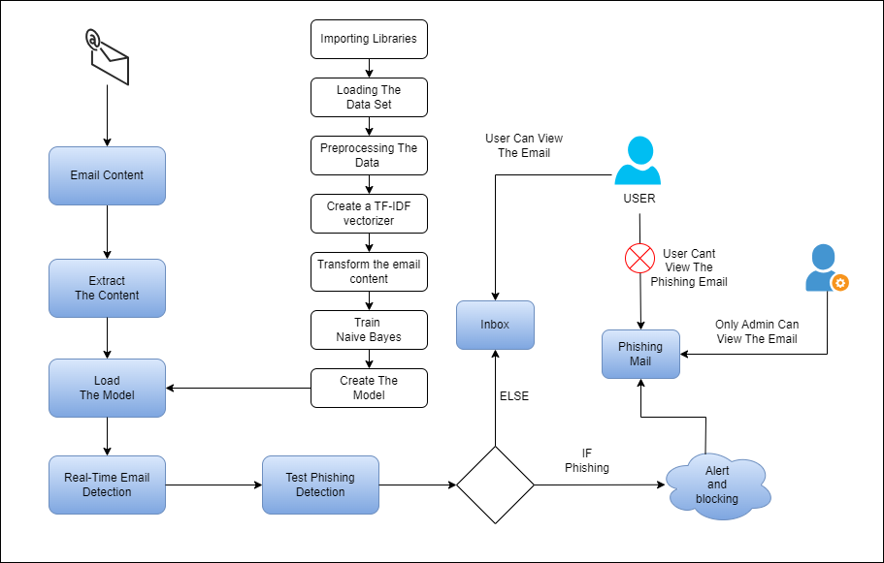
SYSTEM DIAGRAM
IT20650902 | Ahamed RR | TMP-2023-24-082
03/11/2023

Slide 29

WORK BREAKDOWN STRUCTURE
IT20650902 | Ahamed RR | TMP-2023-24-082
03/11/2023

Slide 30
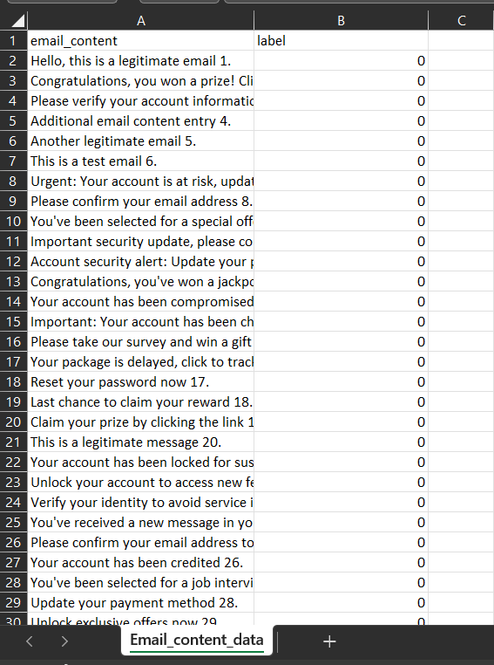
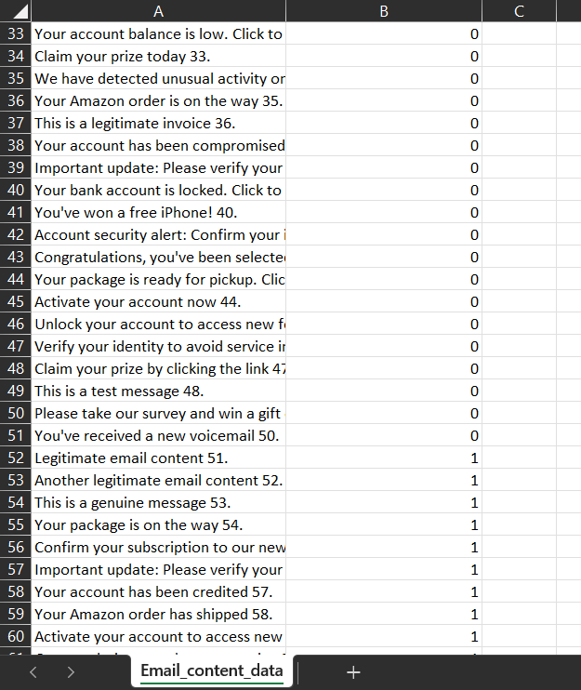
DATASET
IT20650902 | Ahamed RR | TMP-2023-24-082
03/11/2023

Slide 31
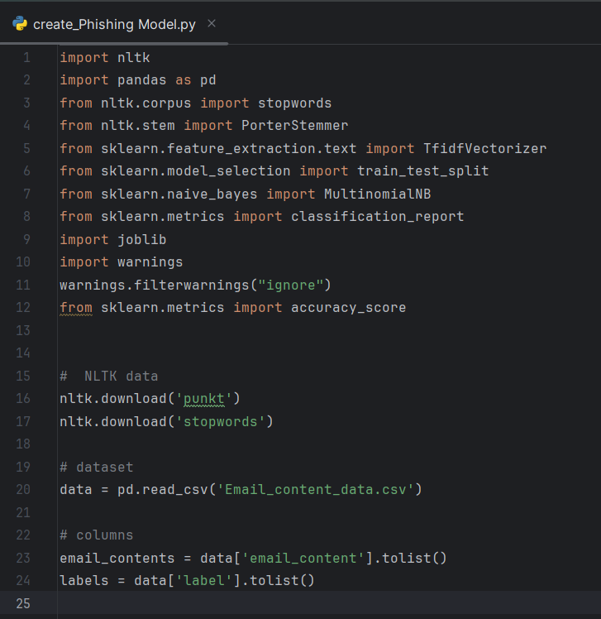
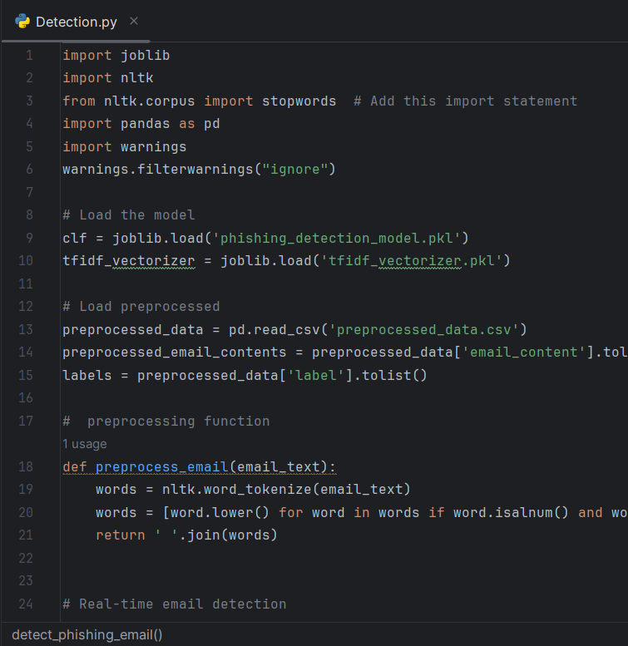
CODE
IT20650902 | Ahamed RR | TMP-2023-24-082
03/11/2023

Slide 32
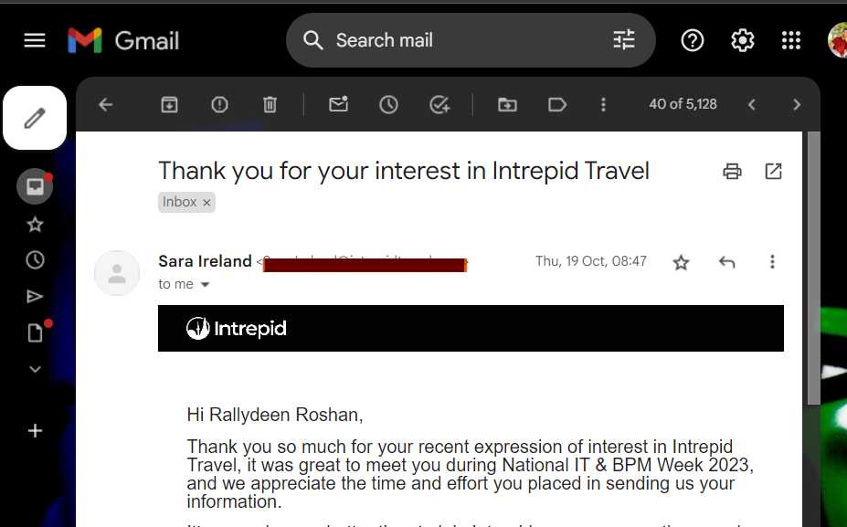
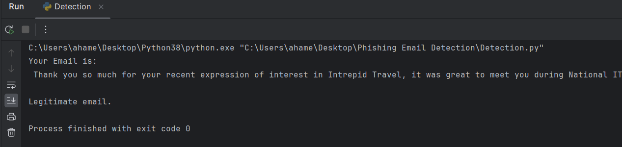
OUTCOME
Legitimate Email
IT20650902 | Ahamed RR | TMP-2023-24-082
03/11/2023

Slide 33
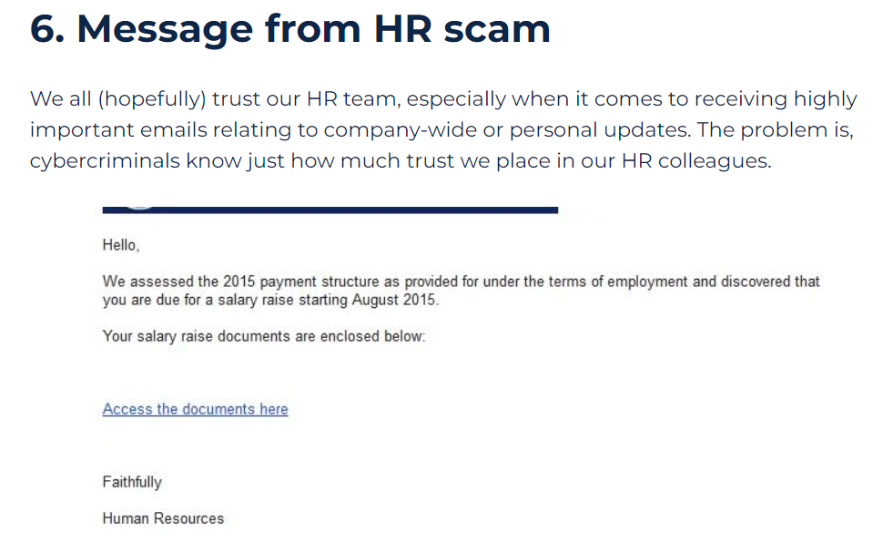
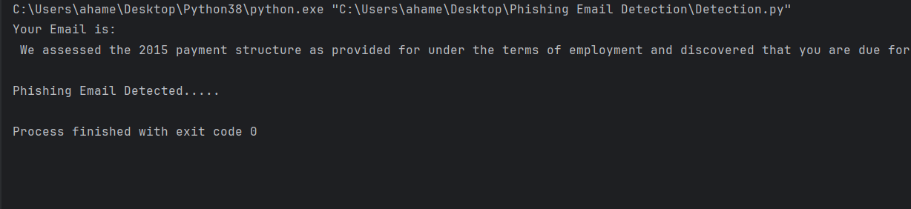
OUTCOME
Phishing Email
IT20650902 | Ahamed RR | TMP-2023-24-082
03/11/2023

Slide 34
DEMO
IT20650902 | Ahamed RR | TMP-2023-24-082
03/11/2023

Slide 35
REFERENCES
[1] Rian Sh. Al-Yozbaky, Mafaz Alanezi, "Detection and Analyzing Phishing Emails Using NLP Techniques," 2023.
[2] Tianrui Peng, Ian G. Harris, Yuki Sawa, "Detecting Phishing Attacks Using Natural Language Processing and Machine Learning," 2018.
[3] Chunduru Anilkumar, Aravind Karrothu, Nandam Sri Mouli, Chaduvula Bhanu Tej, "Recognition and Processing of phishing Emails Using NLP: A Survey," 2023.
[4] Rakesh Verma1, Narasimha Shashidhar2, and Nabil Hossain , "Detecting Phishing Emails the Natural," in IEEE, 2012.
[5] SAID SALLOUM ,TAREK GABER, SUNIL VADERA, KHALED SHAALAN, "A Systematic Literature Review on Phishing Email Detection Using Natural Language Processing Techniques," in IEEE, 2022.
[6] Said Sallouma*, Tarek Gabera,b, Sunil Vaderaa, "Phishing Email Detection Using Natural Language Processing Techniques: A Literature Survey," in IEEE, 2021.
IT20650902 | Ahamed RR | TMP-2023-24-082
03/11/2023

Slide 36

UTILIZING NLP TECHNIQUES FOR CONTENT ANALYSIS IN EMAIL SYSTEMS
FAYAS ACM | IT20637828
CYBERSECURITY
IT20637828 | Fayas ACM | TMP-2023-24-082
03/11/2023

Slide 37

INDUCTION AND BACKGROUND
Analysis and Identifying sensitive information in Email contents.
Importance of Protecting Data from Unauthorized Access.
NLP techniques offer a powerful way to extract sensitive information from Email contents.
IT20637828 | Fayas ACM | TMP-2023-24-082
03/11/2023

Slide 38
RESEARCH PROBLEM
Difficulty in identifying sensitive information from the Email contents.
Improved accuracy and efficiency in sensitive information analysis.
Provide an awareness message or alert to admin notifying them about sensitive information.
IT20637828 | Fayas ACM | TMP-2023-24-082
03/11/2023

Slide 39
OBJECTIVE
Sub-Objectives
Implementing Natural Language Processing (NLP) techniques to analyze documents.
Ensuring the system's accuracy in identifying and flagging sensitive information.
Providing user-friendly interfaces for efficient interaction and understanding of alerts.
Main Objective
To develop an intelligent system that raises user awareness about sensitive information in Email contents and alerts them appropriately.
IT20637828 | Fayas ACM | TMP-2023-24-082
03/11/2023

Slide 40
METHODOLOGY
IT20637828 | Fayas ACM | TMP-2023-24-082
03/11/2023

Slide 41
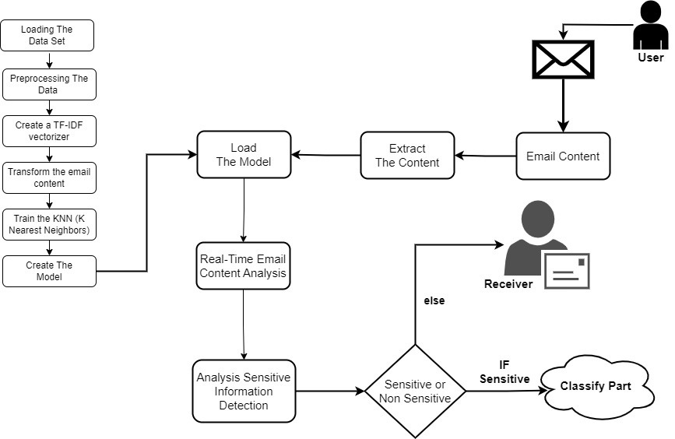
SYSTEM DIAGRAM
IT20637828 | Fayas ACM | TMP-2023-24-082
03/11/2023

Slide 42
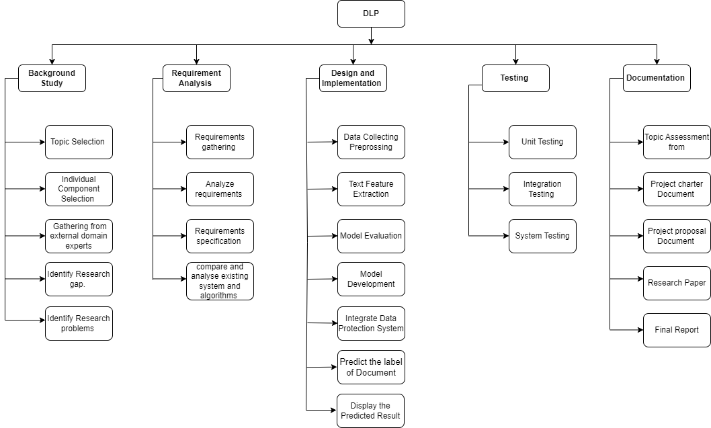
WORK BREAKDOWN STRUCTURE
IT20637828 | Fayas ACM | TMP-2023-24-082
03/11/2023

Slide 43
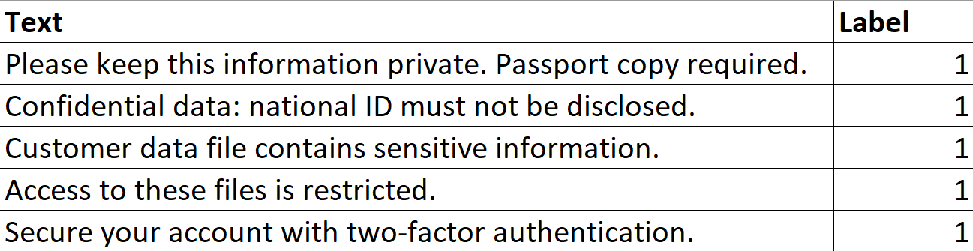
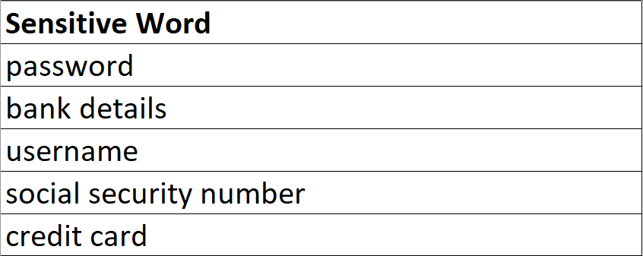
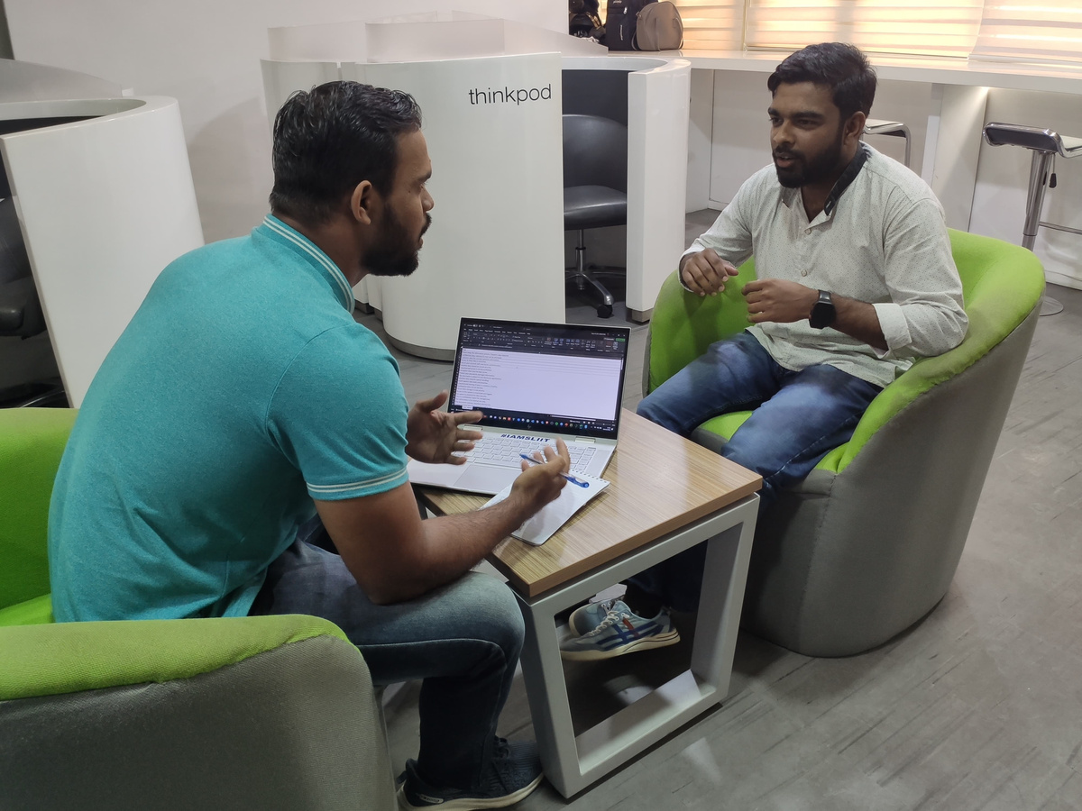
DATASET
Main Dataset
2. Sensitive Words Dataset
Dataset Collected Proof
IT20637828 | Fayas ACM | TMP-2023-24-082
03/11/2023

Slide 44
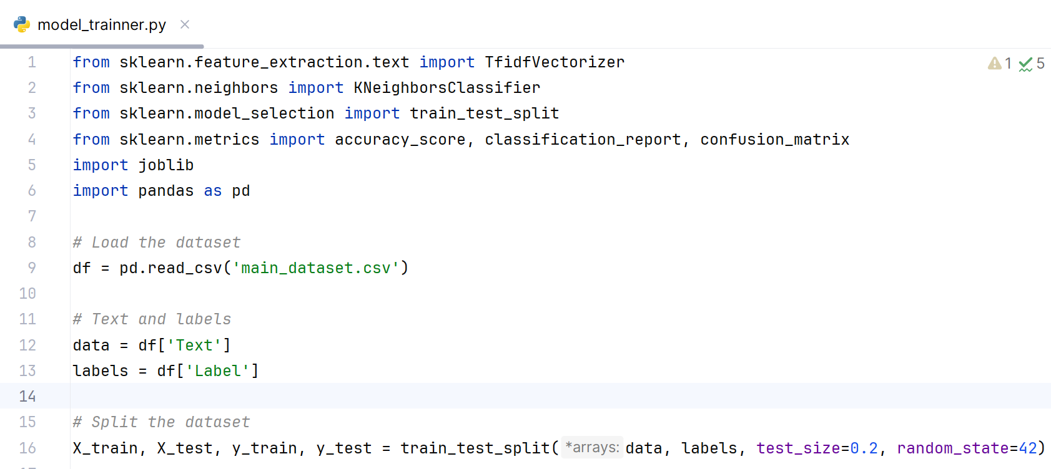
CODE
Model Training Code
IT20637828 | Fayas ACM | TMP-2023-24-082
03/11/2023

Slide 45
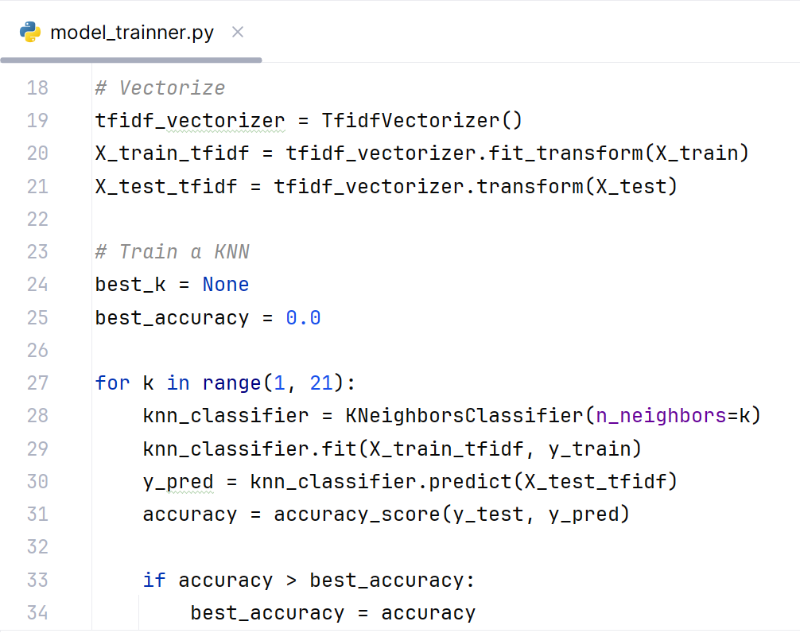
CODE
Model Training Code
IT20637828 | Fayas ACM | TMP-2023-24-082
03/11/2023

Slide 46
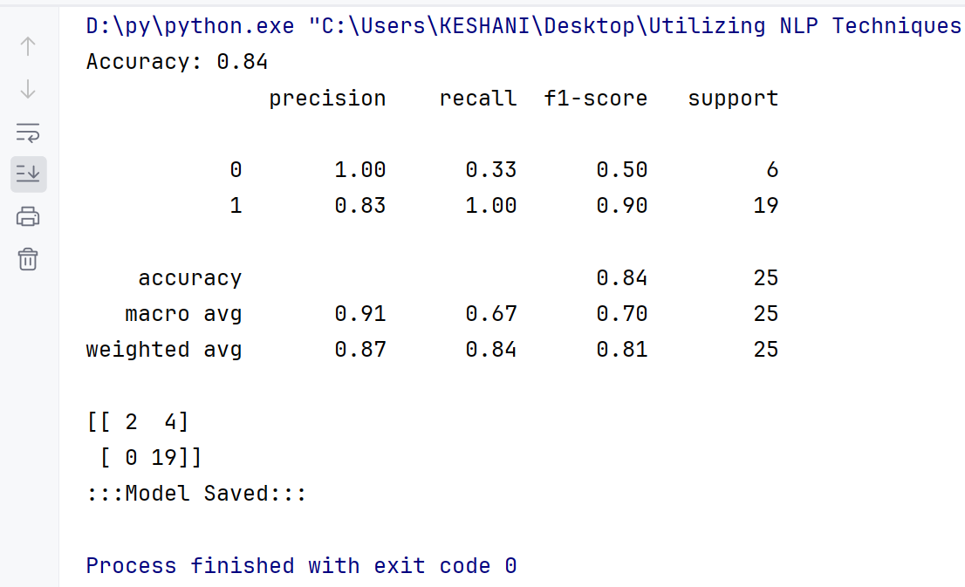
OUTCOME
IT20637828 | Fayas ACM | TMP-2023-24-082
03/11/2023

Slide 47
OUTCOME
IT20637828 | Fayas ACM | TMP-2023-24-082
03/11/2023

Slide 48
DEMO
IT20637828 | Fayas ACM | TMP-2023-24-082
03/11/2023

Slide 49
REFERENCES
[1] Martinelli, F., Marulli, F., Mercaldo, F., Marrone, S., & Santone, A. (2020). Enhanced privacy and data protection using natural language processing and artificial intelligence. 2020 International Joint Conference on Neural Networks (IJCNN), 1–8.
[2] Vaidya, N. (n.d.). 5 natural language processing techniques for extracting information. Aureusanalytics.com. Retrieved August 1, 2023, from https://blog.aureusanalytics.com/blog/5-natural-language-processing-techniques-for-extracting-information
[3] (N.d.). Researchgate.net. Retrieved August 1, 2023, from https://www.researchgate.net/publication/326264437_Natural_Language_Processing_for_Information_Extraction
IT20637828 | Fayas ACM | TMP-2023-24-082
03/11/2023

Slide 50

CLASSIFY DATA LEAKAGE LEVEL WITH MACHINE LEARNING
Keshani SK | IT20299002
CYBERSECURITY
IT20299002 | Keshani SK | TMP-2023-24-082
03/11/2023

Slide 51
BACKGROUND
Classifying data leakage levels using machine learning for
proactive data protection.
Interactive classification dashboard for real-time monitoring of email sensitivity.
Enhancing data security by prioritizing responses based on sensitivity levels.
Contributing to data breach prevention through advanced DLP strategies.
IT20299002 | Keshani SK | TMP-2023-24-082
03/11/2023

Slide 52
RESEARCH PROBLEM
Effective feature selection for accurate data leakage level classification.
Real-time monitoring and alerting to improve incident response times.
Adapting machine learning models and NLP to evolving data leak threats.
Optimizing confidence scoring for reliable sensitivity information.
IT20299002 | Keshani SK | TMP-2023-24-082
03/11/2023

Slide 53
OBJECTIVE
Sub-Objectives
Validate and optimize machine learning models for data leakage level classification.
Create an interactive classification dashboard for user-friendly monitoring and management.
Implement real-time alerting to respond promptly to potential data leak threats and generate a report.
Main Objective
Classify the severity of data leakage incidents using machine learning and NLP to prioritize responses and minimize damage
IT20299002 | Keshani SK | TMP-2023-24-082
03/11/2023

Slide 54
METHODOLOGY
IT20299002 | Keshani SK | TMP-2023-24-082
03/11/2023

Slide 55
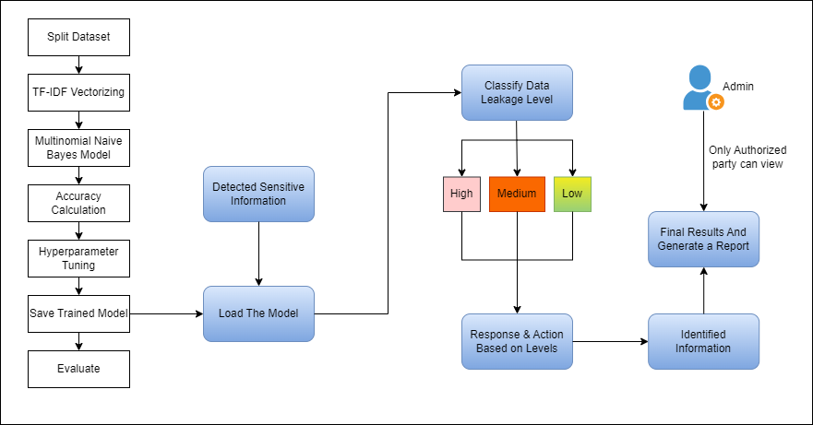
SYSTEM DIAGRAM
IT20299002 | Keshani SK | TMP-2023-24-082
03/11/2023

Slide 56
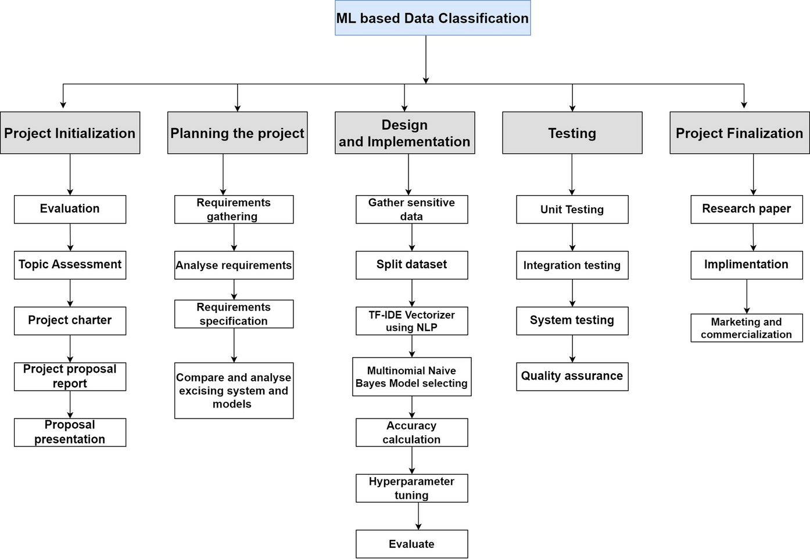
WORK BREAKDOWN STRUCTURE
IT20299002 | Keshani SK | TMP-2023-24-082
03/11/2023

Slide 57
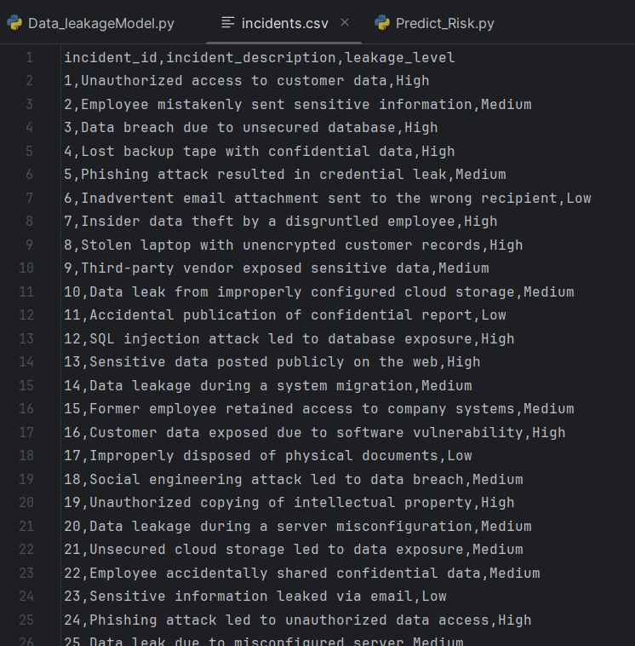
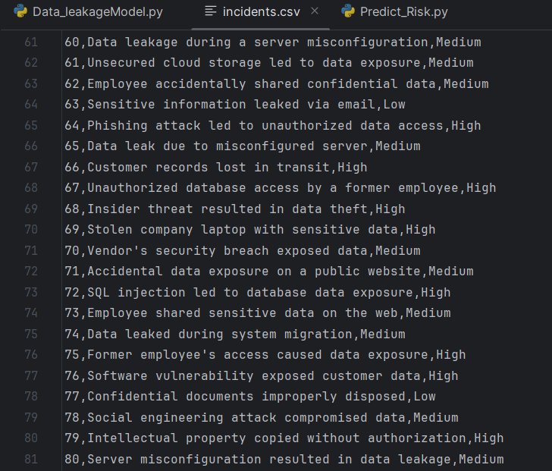
DATASET
IT20299002 | Keshani SK | TMP-2023-24-082
03/11/2023

Slide 58
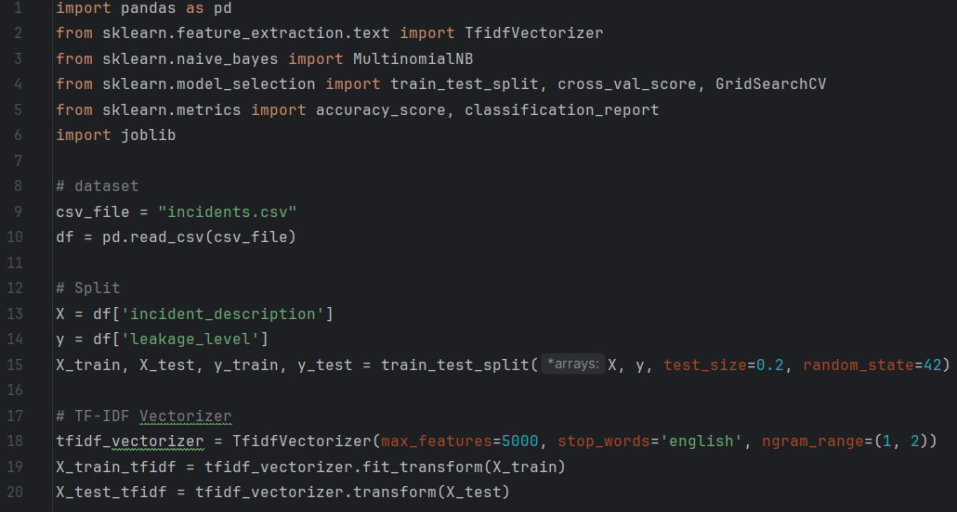
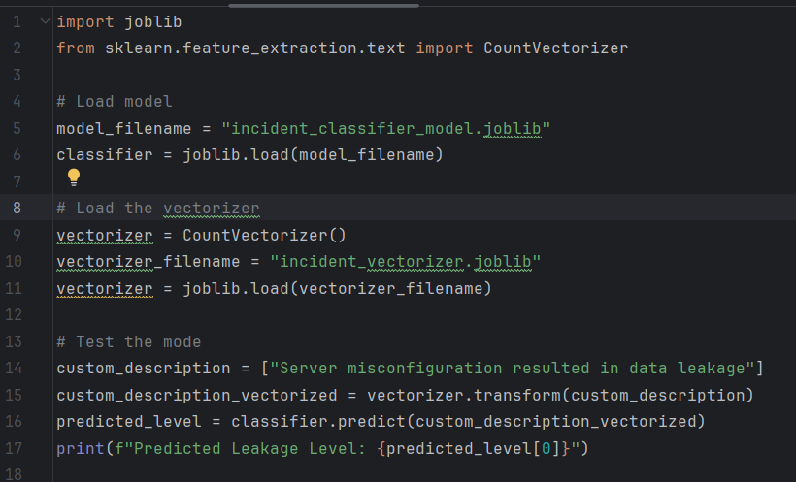
CODE
IT20299002 | Keshani SK | TMP-2023-24-082
03/11/2023

Slide 59
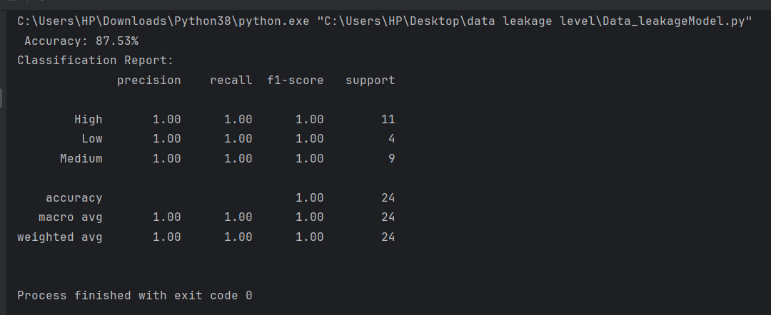
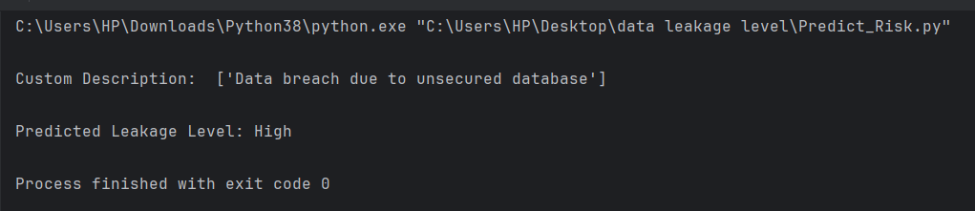
OUTCOME
IT20299002 | Keshani SK | TMP-2023-24-082
03/11/2023

Slide 60
DEMO
IT20299002 | Keshani SK | TMP-2023-24-082
03/11/2023

Slide 61
REFERENCES
[1] Andersson, S. (2023). Problems in information classification: insights from practice. Information and Computer Security, 31(4), 449–462. https://doi.org/10.1108/ics-10-2022-0163
[2] big data classification Latest Research Papers. (n.d.). Sciencegate.App. Retrieved November 3, 2023, from https://www.sciencegate.app/keyword/744391
[3] Email & document classification. (n.d.). Dataclassification.com. Retrieved November 3, 2023, from https://www.dataclassification.com/solutions/email-document-classification/
[4] (N.d.). Researchgate.net. Retrieved November 3, 2023, from https://www.researchgate.net/publication/320549282_Data_Classification_Using_Machine_Learning_Approach
IT20299002 | Keshani SK | TMP-2023-24-082
03/11/2023

Slide 62
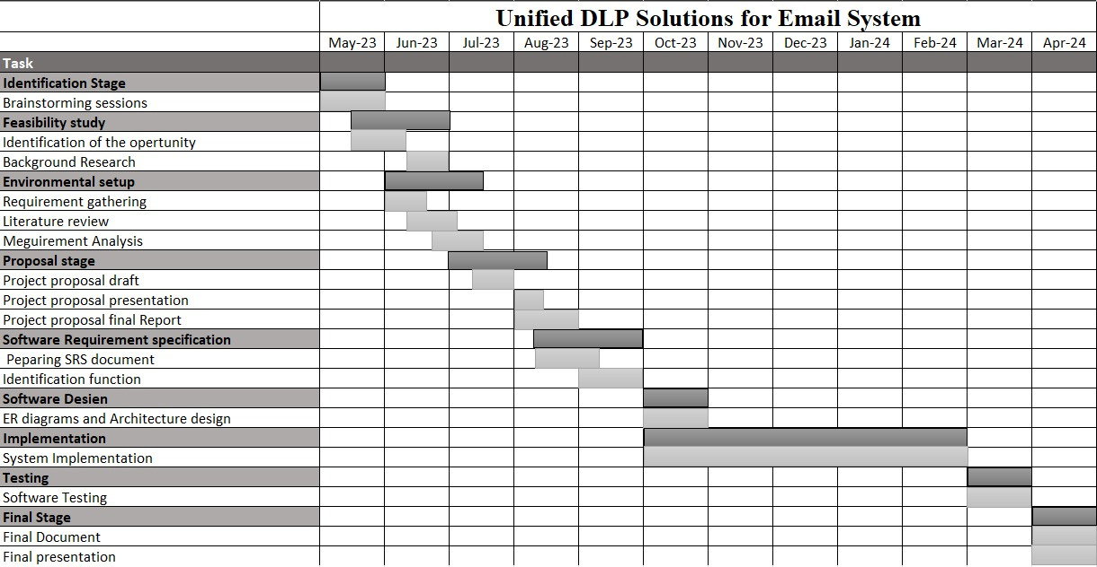
GANNT CHART
03/11/2023

Slide 63

03/11/2023

Slide 64
Thank You

